Slide 1


Civitas Networks
Enabling 5G Smart Community Solutions
Civitas Networks Confidential 2021
Notes:
1. Solution to what?

Slide 2

Civitas Smart Cities
Civitas builds custom networks that enable next generation of data and communication
We enable Smart data harvesting from sensors (temperature, water, traffic and pedestrian flow)
5G is only as good as data processed for the the community, and is only truly beneficial with local data accessibility
5G service with near zero investment from the community
We enhance the use of Transportation development funds from DOT
Civitas is far more cost effective than traditional cable and wireless carriers
Civitas Networks Confidential 2021

Slide 3
CIVITAS Vision
Civitas disrupts the traditional telecom model by creating a smart town/municipal system, producing hyper-local data precisely designed for the present and future needs of the community
Civitas owns and operates the network so there is no out of pocket expense from the municipality
High Speed (5G) Data Connectivity from standards-based, stable, reliable infrastructure
Advanced technologies that can monitor everything from energy use to waste management
Provides MNOs with a 5G municipal platform for rapid growth
Civitas Networks Confidential 2021

Slide 4
Civitas Delivers on What is Important to the Community’s development
Social
Broadband services to cross the digital divide
Economic Development
Enhanced infrastructure services-higher uptime-lower cost
Public Safety
Traffic/Congestion Management – Advanced lighting
Mobility
EV charging for climate aligned mass and personal transit
Education
LFH / WFH and life-long learning support
Risk/Financial Management
Asset-level intelligence - critical infrastructure/services
Civitas Networks Confidential 2021

Slide 5
Students are Learning from Home
Situation
Broadband data is needed in homes now to provide a virtual path to learning as physical presence is not possible right now
Answer
Create a quick, secure, and reliable home data delivery systems for students and workers ith dedicated private networks
System is easy to use, fast, and safe for students
Civitas Networks Confidential 2021

Slide 6

Benefits of Civitas Private Networks
A custom fit system designed around the community's needs, not for the sole benefit of a Mobile Network Operator (MNO)
The system is expandable and designed to grow with the community's needs and smart city goals, using the best fit technology
The community can add services such as lighting and and smart sensors
The community can use the sensor data collected to improve its services and systems, and financially benefit by sharing selected data with analytic service companies
Civitas Networks Confidential 2021

Slide 7








Our Focus Support the Community, provide actionable data and measurable benefits, manage risk and resiliency, enhance service
Government Efficiency Governance effectiveness and ease of doing business
Cyber Security/Resilience Data Integrity
Sustainability Environmental, energy, water and air quality management
Economic Development Business, employment and productivity
Health and Wellness Mental, physical and social care and well being
Public Safety Welfare and protection from crime, hazards and disasters
Mobility Transportation, transit and traffic management
Quality of Life Standard of living,
satisfaction and happiness
The impact - Measurable results in operational, financial and ESG metrics
Civitas Networks Confidential 2021

Slide 8

What Civitas delivers
Complete integrated networks to meet smart city plans
Virtualized 5G Cloud Core
5G high speed data
Hyper local data to know about your community than ever before
A sensor platform for MIOT – AQI, video, acoustic, EV Charging
Pure Sunlight color street lighting
All housed in Attractive Street poles
Civitas Networks Confidential 2021

Slide 9
Hyper Local Data For Community Use
The community uses the data collected to improve its services and systems, and financially benefit by sharing selected data with analytic service companies
Demonstrated efficiency in city management can translate into better capital markets reception and save many $ millions over the years
Municipal Systems Monitoring
Water, sewage, and electrical status and use
Streetlight monitoring & Control
Traffic flow through town
Weather update to citizens
Police monitoring town events
Civitas Networks Confidential 2021

Slide 10
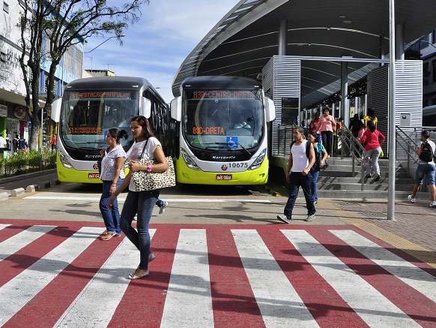
Sensors for monitoring systems and services
Municipal Infrastructure for Future Growth
Sensors for Water, Sewer, Electric, Traffic Monitoring
Increase to Property Values
Work from Home Benefits
Post-COVID Requirements for 40-50% of workers to be able to work remotely
More Attractive to Business Growth
High Tech Companies need high speed data and services
Wholesale Fiber Capacity to nearby municipalities and corporate clients
Civitas Networks Confidential 2021

Slide 11
Community benefit without the expense
Community gets a high-speed network with sensor technology
Guaranteed throughput for internet access
No throttling down due to increased usage
Cost is covered by supporting MNO customers and anonymized sensor data
Civitas Networks Confidential 2021

Slide 12
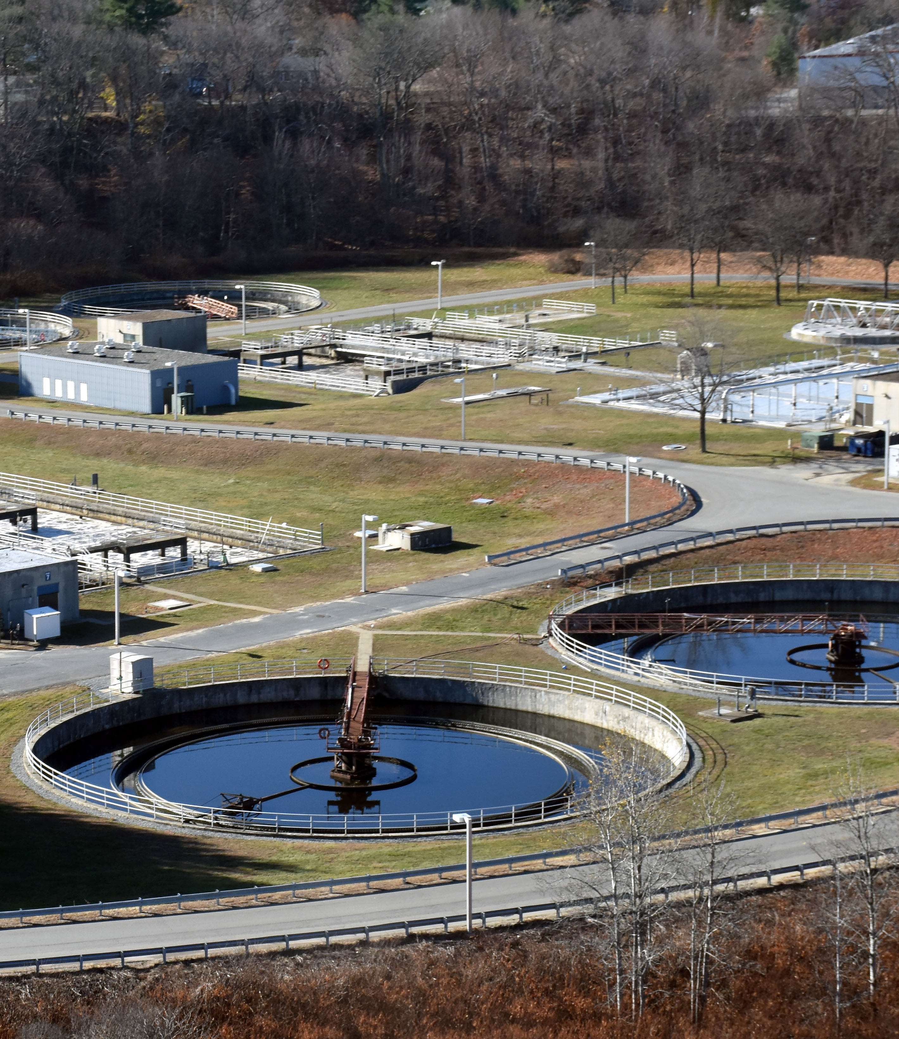
Municipal Applications
Water electrical and wastewater grids
Comms energy wastewater
Transportation and Public safety
Civitas Networks Confidential 2021
Notes:
We should map these examples to:
The segmentation scheme in slides up front
The examples to follow
The graphic in here is of a refinery … we will not be in oil and gas, I do not think … unless we are dragged in … which we could be … this is one of the major topics we need to nail down …
Who are the target customers?
How tight should that circle be?
Will we go outside that circle? When how why?

Slide 13
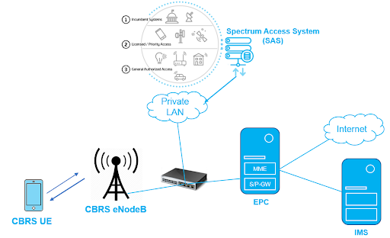

Dedicated Private CBRS Network
Private CBRS networks cover more area than Wi-Fi and provide stronger security
Virtualizes MNO clients
Fully hosted core network that supports data and voice
User devices are managed with a SIM card
(Evolved Packet Core)
Home Unit
(CPE)
(IP Multimedia Subsystem)
Civitas Networks Confidential 2021

Slide 14
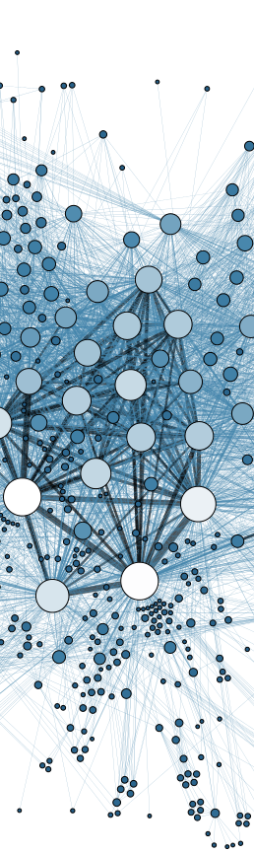
Sensor Data for Hyper Local and Asset Intelligence
Each Pole will house sensors and be the hub for nearby sensors
With thousands of new locations sampling air quality, temperature and more, Communities gain a new resource for predictive planning
Communities can use hyper-local temperature mapping to prioritize the top locations for road salting in winter
Hyper-local Air Quality sensors can better predict community health issues
Water sensors can provide farming communities with much better planning of water resources, reducing costs
Civitas Networks Confidential 2021

Slide 15
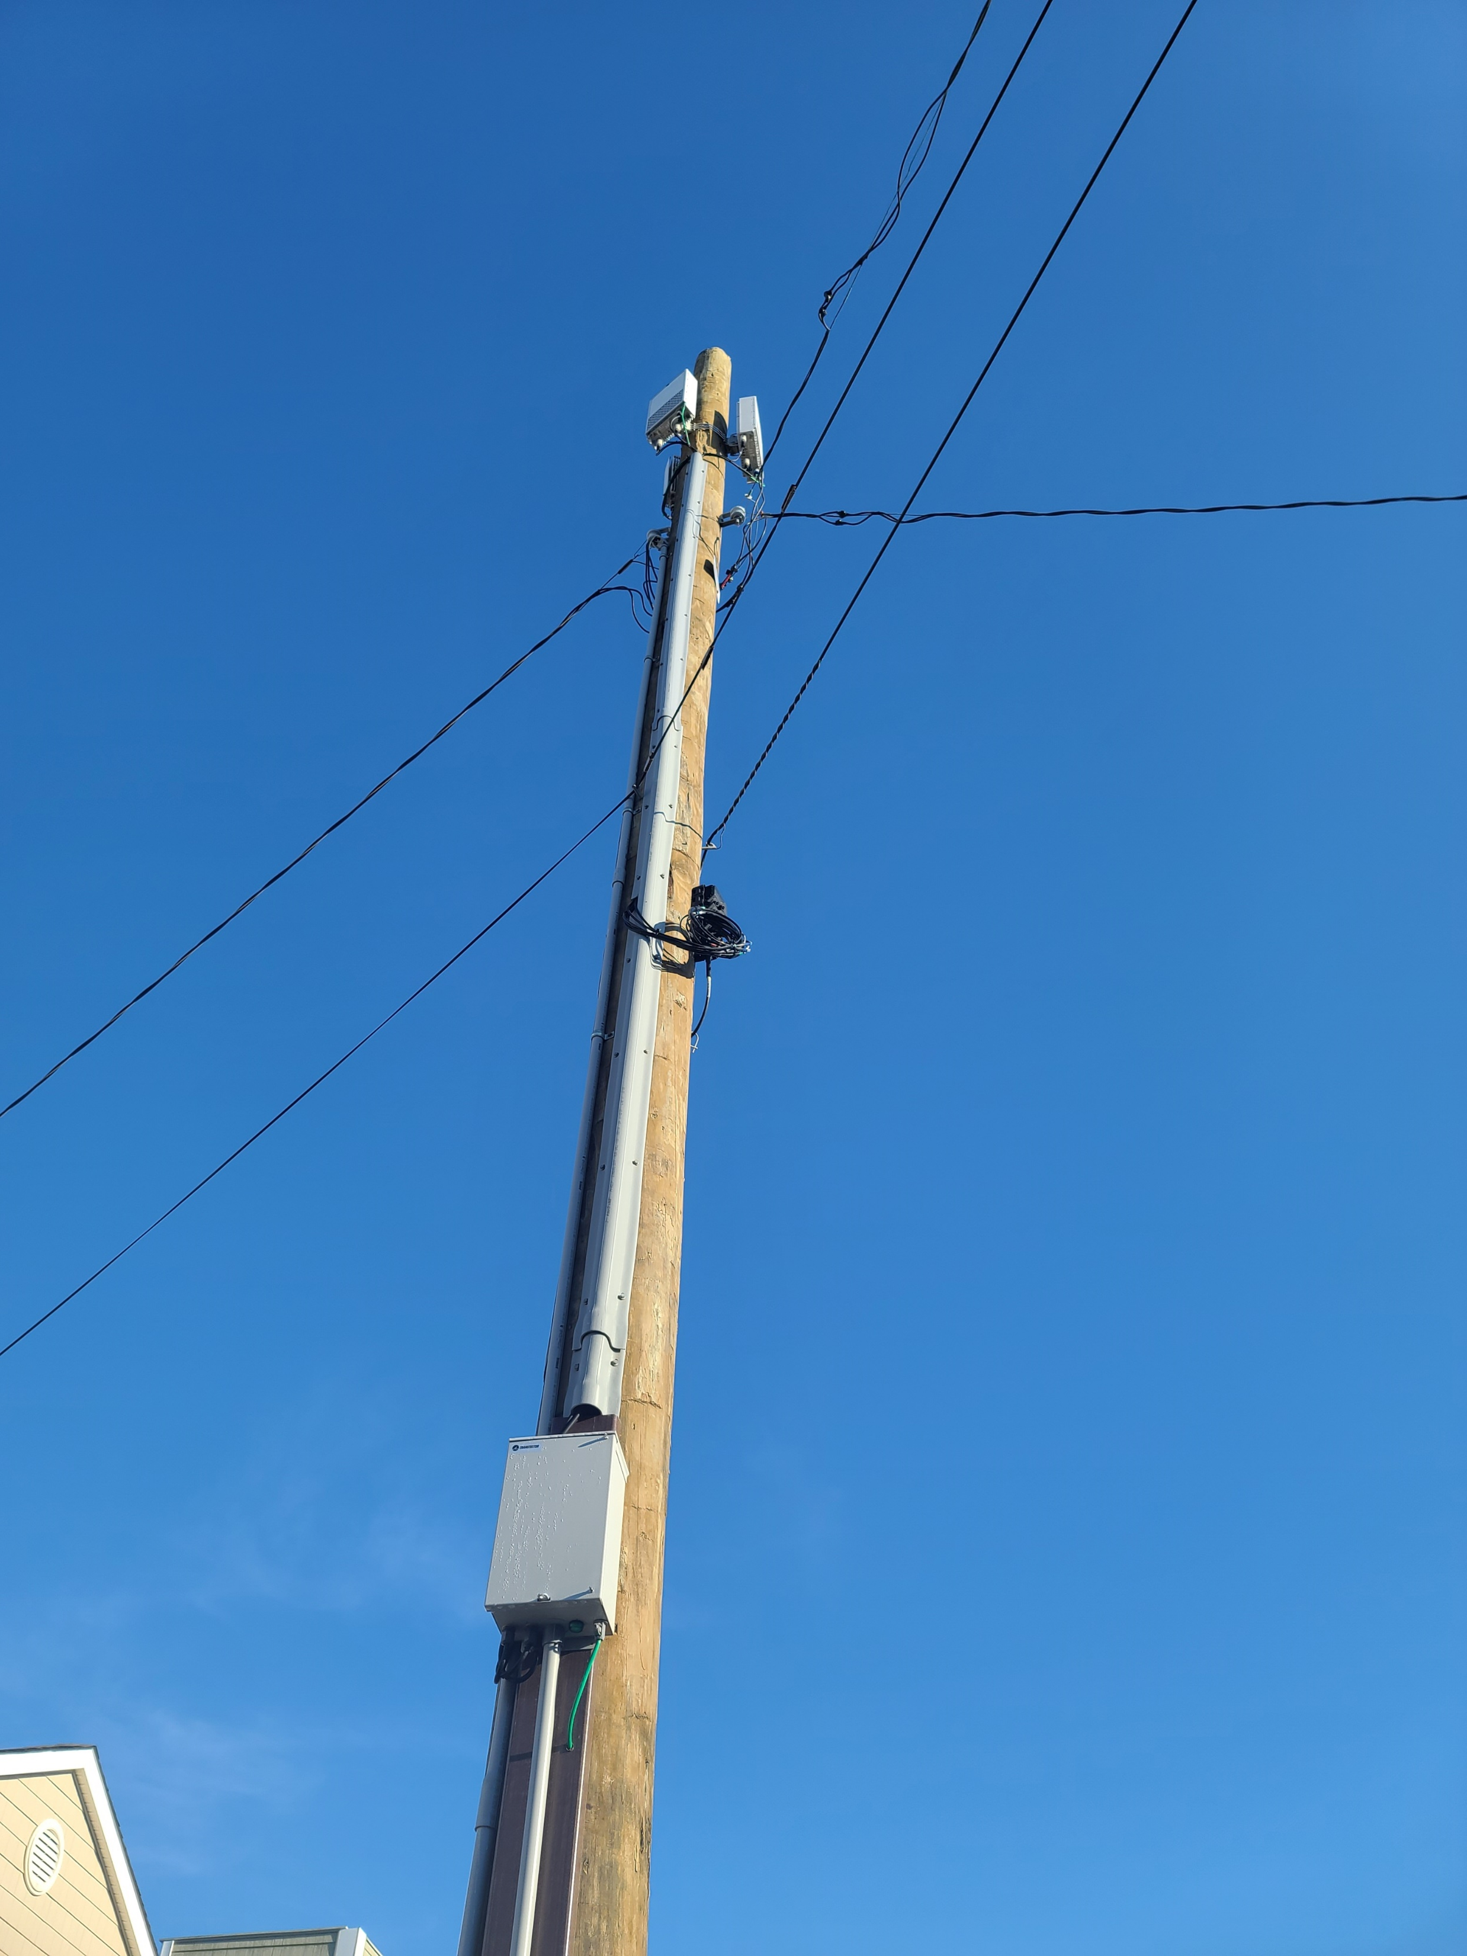
Typical MNO 5G Site
No consideration for aesthetics
Too high above street to support full mmwave 5G
All externally visible equipment on an already loaded telephone pole – short term solution
Civitas Networks Confidential 2021
Notes:
Carrier design 5G pole

Slide 16
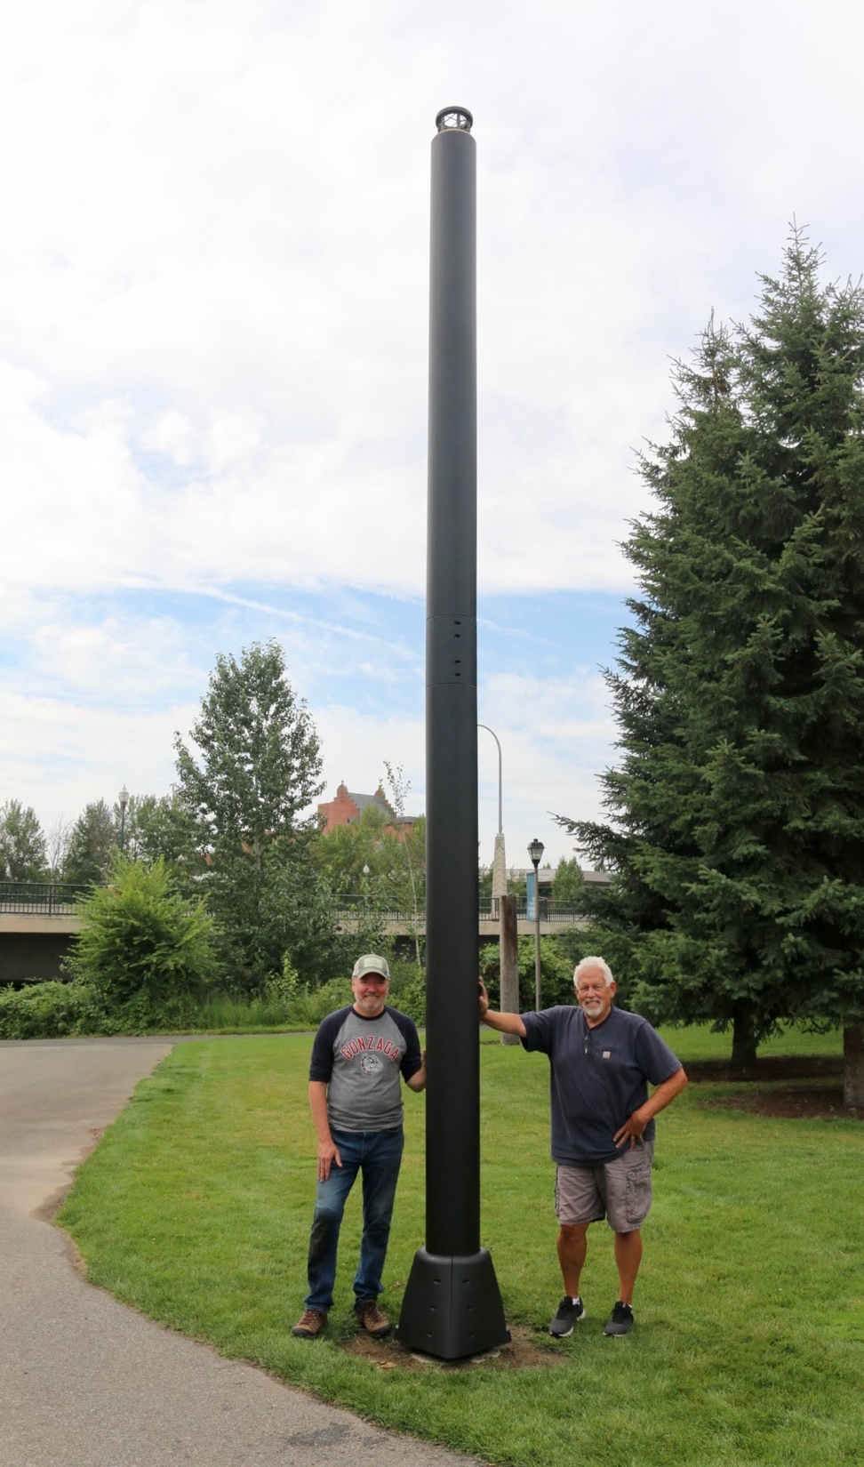
Civitas Smart Pole Solution
Unobtrusive Carbon fiber pole with color matching dense foamed cladding
A composite structure with the highest strength to weight ratio of any pole material
Only 12% the weight of steel
All Equipment is inside the pole or in the ground
Small high efficiency Lighting Unit matches look of existing street lighting
Meets all electrical and DOT standards
Civitas Networks Confidential 2021
Notes:
I think this is a specious argument … no offense … not sure that you can say it blends in any better than the fake tree … we can over-sell this pole and miss the point – and the opp …
We need higher density POPs
We need them to be low-footprint and low-impact
We need them to be secure AND agile
This is not the core service, this is the chassis
This is not the core value proposition, this is the chassis

Slide 17
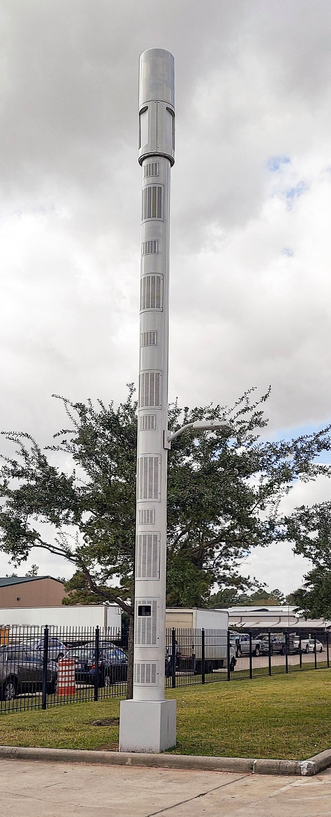
Hosted Carrier Pole
Clean look with no protruding equipment
Supports up to four Mobile Network Operators plus 5G CBRS
Separate access for each MNO
Local power meter
Integrated or top mount antennas
Optional Sensors and lighting
Company Confidential 2020

Slide 18


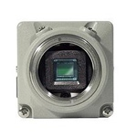


General Utility Example: Internally Mounted Equipment
5G Radio
Coaxial Plasma Luminaire
Video / Thermal Camera
Air Sensors
Emergency Button
EV Charging Point
Civitas Networks Confidential 2021

Slide 19
Community’s Smart City Plan is Developed with Civitas
Engage
Develop a Policy
Community Smart City Needs
Study the people, businesses, and visitors
Define Roles and Requirements, Strategies and Objectives
Transportation, Health, Sensors, Mobility, Data, Security
Civitas Networks Confidential 2021

Slide 20
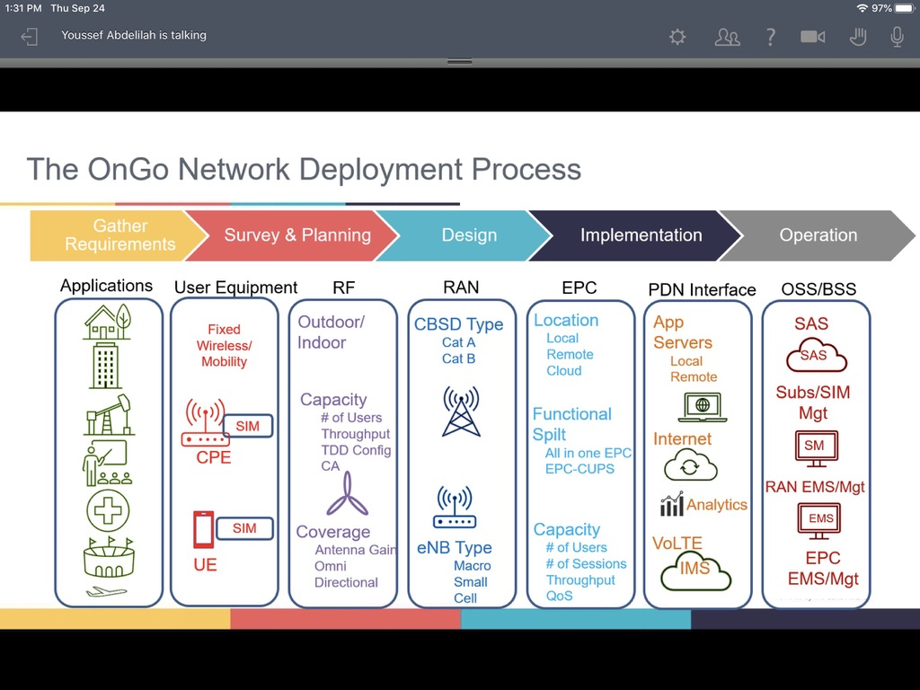
Network Deployment Process
Civitas works with you every step of the way to develop a plan that turns your smart city ambition into a reality
No cost to the municipality
Civitas operates the networks for the municipality
The community now has new ways to monitor city systems
Verifies city systems such as water, traffic, and lighting
Civitas Networks Confidential 2021

Slide 21
The Process
Review community goals, budget, and projections post network
Propose system solution
Implementation roadmap
System design with integration plan
Pilot system launch and modifications and evaluation
Approval and Commissioning
Launch system
Civitas Networks Confidential 2021

Slide 22

Industrial Grade Security
Cyber Physical Resilience
Operational Security
Data Integrity
CIVITAS partner network sensors support the markets’ acute demand for
Asset intelligence
To support new levels of operational, financial and ESG (starting with climate physical risk) performance
With data that can be trusted
Civitas Networks Confidential 2021

Slide 23
Next Steps
Meeting with community to discuss goals and plans
Civitas to make a network model for community review
Define town "limits"
Develop pay models for business and home access
Agree on terms for lease of equipment and services
Civitas Networks Confidential 2021

Slide 24

Conclusion
Civitas’s unique approach to 5G fills the need for community’s looking for privacy, security, and a more useful network based on their needs on not the MNOs
5G private networks will improve a community’s way of life and bring new sources of revenue
Better looking and fitting equipment will ease deployment issues, enhancing the value of the community
Civitas works closely with the community to ensure their 5G and smart community needs are part of the equation
Civitas Networks Confidential 2021

